Slide 1

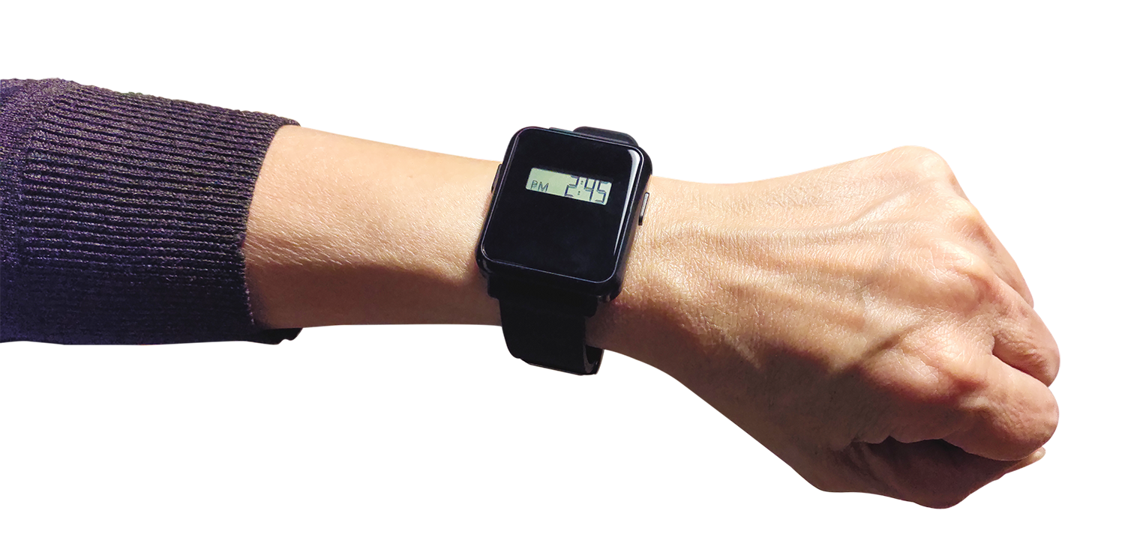
Care Active
Data Processing
2023/Jul/6

Slide 2
Care Active
1
Generation 1 Data Format
Max CVL (30”)
Motion
CVL
Seq
No Motion
Control Message

Slide 3
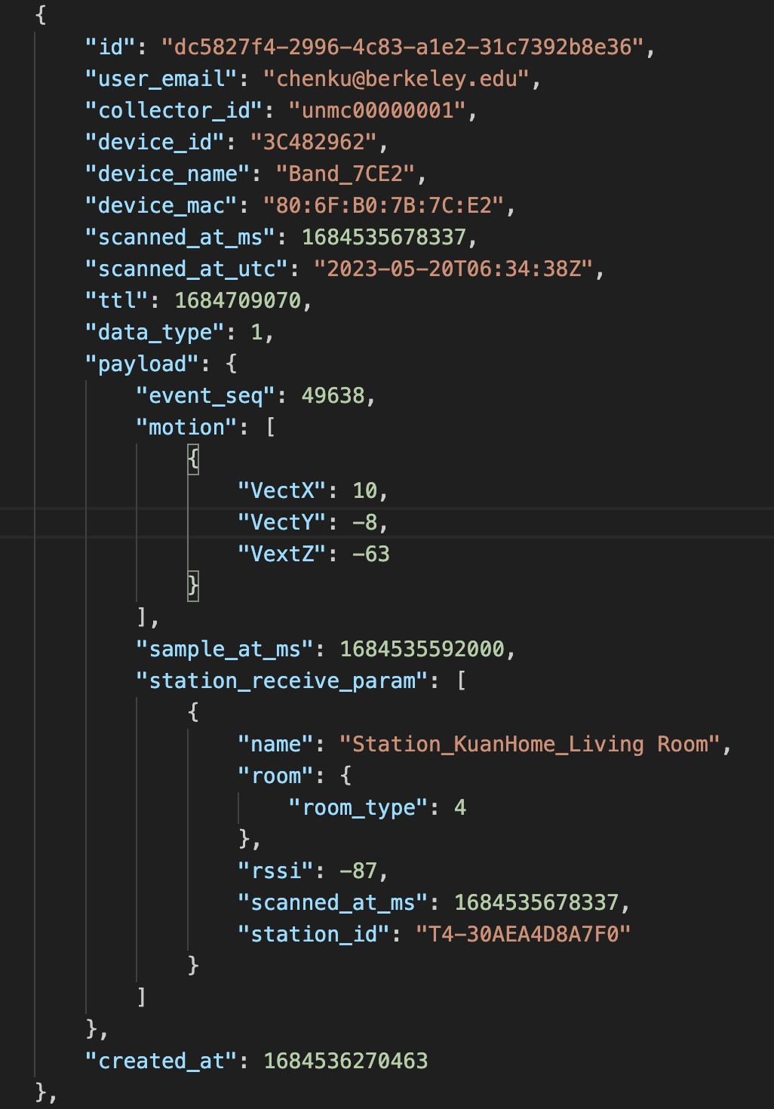
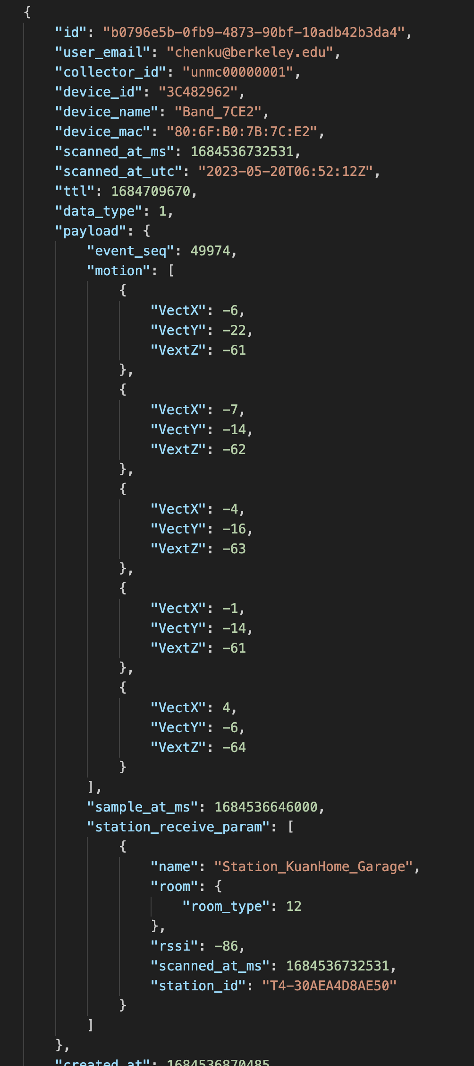
Care Active
1
Generation 2 Data Format
No Motion
With Motion

Slide 4
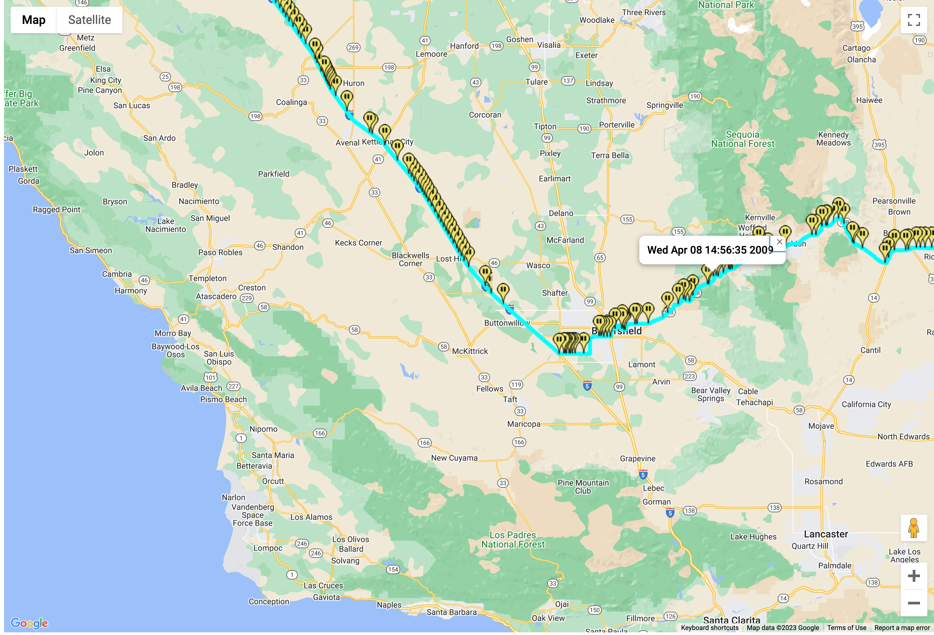
Care Active
1
GPS Data
Proposal:
Raw → KML
Use KML Viewer online:
https://kmlviewer.nsspot.net/

Slide 5
Care Active Technology for Greater Peace of Mind
Care Active, Inc.

